Slide 1
Data Collection for Sign Language Classification

Slide 2
American Sign Language
Communication based on hand gestures
One gesture for each letter of the alphabet, with some involving motion
Motivation of this project is Automatic Sign Language translation using Convolutional Neural Networks (CNN)
One step closer to inclusive smart cities for the Deaf & Mute community

Slide 3
Assignment-3 Part 1 : Data Collection
Good dataset is key for a good Machine learning model
And sometimes we need to create our own data!
Steps in Data Collection
Familiarize with American Sign Language Gestures for letter from A - I (9 letters)
Ask your friend to take three pictures at slightly different orientation for each letter gesture using your mobile phone
Ensure adequate lighting and a white background while capturing the images.
Use your right hand to create gestures (for consistency).
Keep your right hand fairly apart from your body and any other obstructions.
Transfer the Images to your laptop for cleaning.
https://static.memrise.com/uploads/things/images/30101096_140417_0005_33.gif

Slide 4
Data Cleaning
During this process, we crop out the unnecessary image parts
Approximately center the hand on the cropped region
End up with a SQUARE aspect ratio cropped image. (224x224 Px.)
Mac - We can achieve this using the application “Preview”
Hold down CMD + Shift will keep square aspect ratio while selecting the hand area
Windows 10– Use ‘Photos’ app to edit and crop the image and keep a square aspect ratio
Use “Paint” to resize the image to the final image size of 224x224 pixels
Linux – You can use GIMP, or imagemagick, or other tools of your choosing

Slide 5
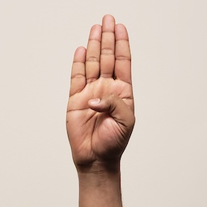
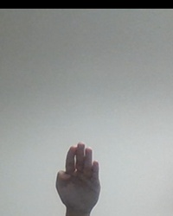
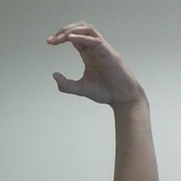
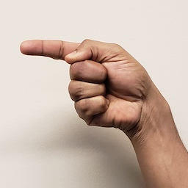
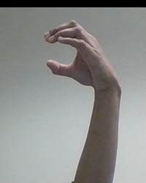
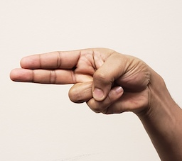
Accepted image specification
✅
❌
Final Image size 224x224 pixels RGB
File format is .jpg
Hand approximately centered on the frame
Hand is not obscured
Hand should not be cut off
Avoid shadows
Follow the ASL gestures posted earlier

Slide 6
Submission details
Image file names should follow the convention of student-number_Alphabet_file-no.jpg
Example : 100343434_A_1.jpg
Zip all the images together and name it with the following convention : last-name_student-number.zip
Example : last-name_100343434.zip
Upload the zipped folder.
We will be anonymizing and combining everyone’s images. We will announce when the combined data set will be available for download.

Slide 7
COMMON ERRORS OBSERVED
Resolution 223x223, 244x244!!!
File name Image_123.jpg, A1s.jpg , 20190220_12121.jpg !!!
Shadows – If YOU can’t distinguish the gestures, it is going to be even harder for the model.
Use of dash instead of Underscore.

